Slide 1
Interactive Methods for Studying Foreign Languages in Technical Higher Educational Establishments
Alla A. Slobodianiuk
Foreign Languages Department

Slide 2
A method ( from Greek - «way» ) – is a process of co-operation between teachers and students, which results in a transmission and mastering of knowledge, abilities and skills, foreseen by the content of studies.

Slide 3
The Passive Method
a student
a student
a teacher
a student
a student

Slide 4
The Active Method
a student
a teacher
a student
a student

Slide 5
The Interactive Method
a student
a teacher
a student
a student

Slide 6
Learning Pyramid
Lecture
5%
Reading
10%
20%
Audio-Visual
30%
Demonstration
50%
Discussion Group
75%
Practice by Doing
90%
Teach Others / Immediate Use

Slide 7
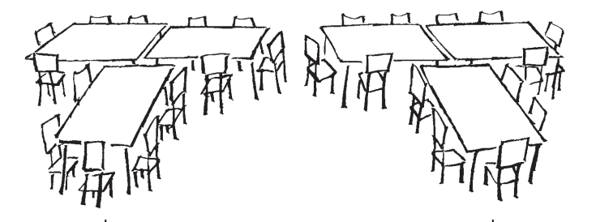
“Double T” Formation

Slide 8
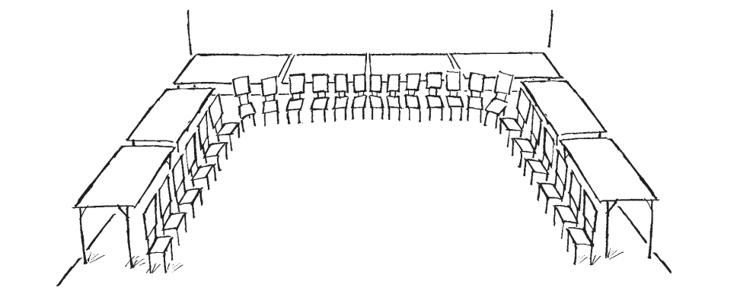
“U” Formation

Slide 9
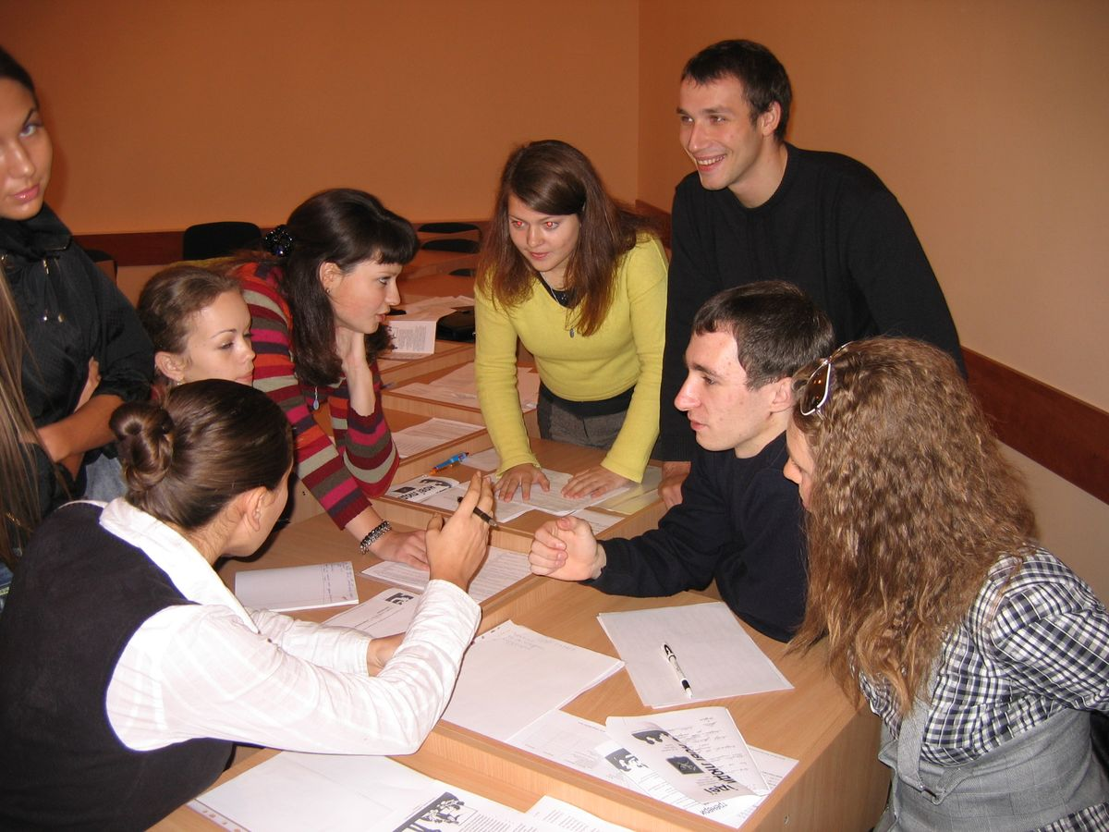
Small Groups
Students can be divided into groups of two or three people. Smaller groups are better as they facilitate more discussion, they help the students get interested in the topics being discussed and they build better relationships. The teacher can listen in on each group as they discuss to ensure that they are following instructions and discussing ideas relevant to the question. After the discussion, each group can present its ideas.

Slide 10
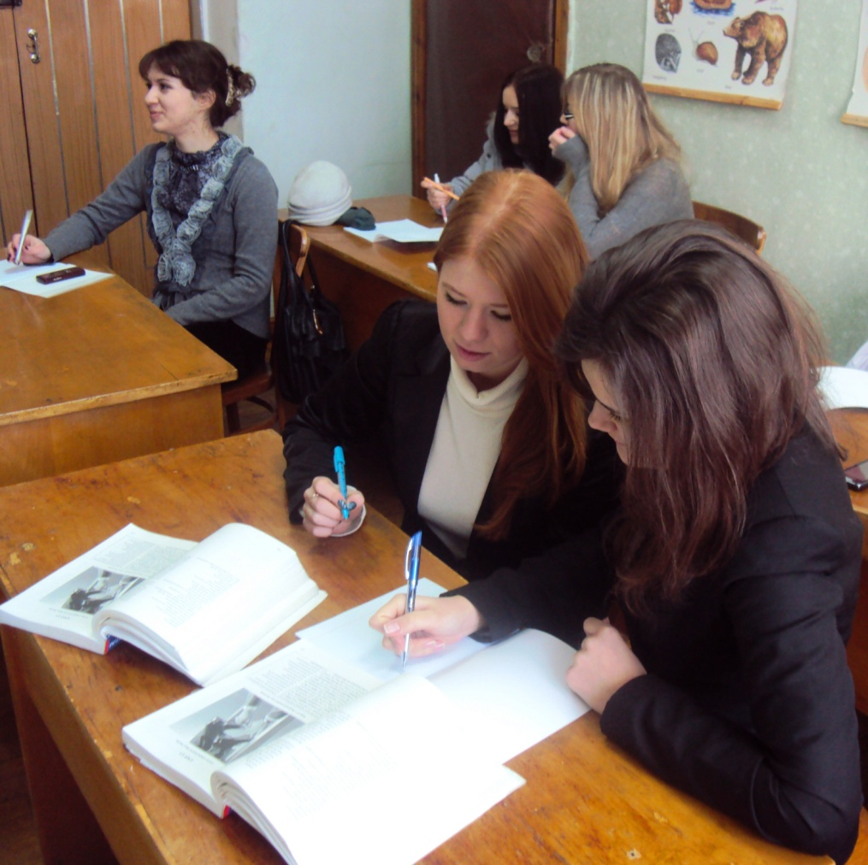
Pair Work
Pair work is a classroom activity in which the whole group is divided into pairs. The idea of pair work is to improve listening and speaking skills by requiring students to exchange information with each other.

Slide 11
Games are efficient techniques to achieve learning goals by providing a background in which linguistic units are repeated and reinforced. To be effective, games should not be time consuming; they should involve most students; and they should be adaptable to most classes and student levels of proficiency.
Business games that mirror an entire company's operations can be used to teach students about decision making, and the impact a single decision can make on the entire organization. Playing business games teaches students about critical organizational rules and the relationships necessary to meet and exceed performance expectations.

Slide 12
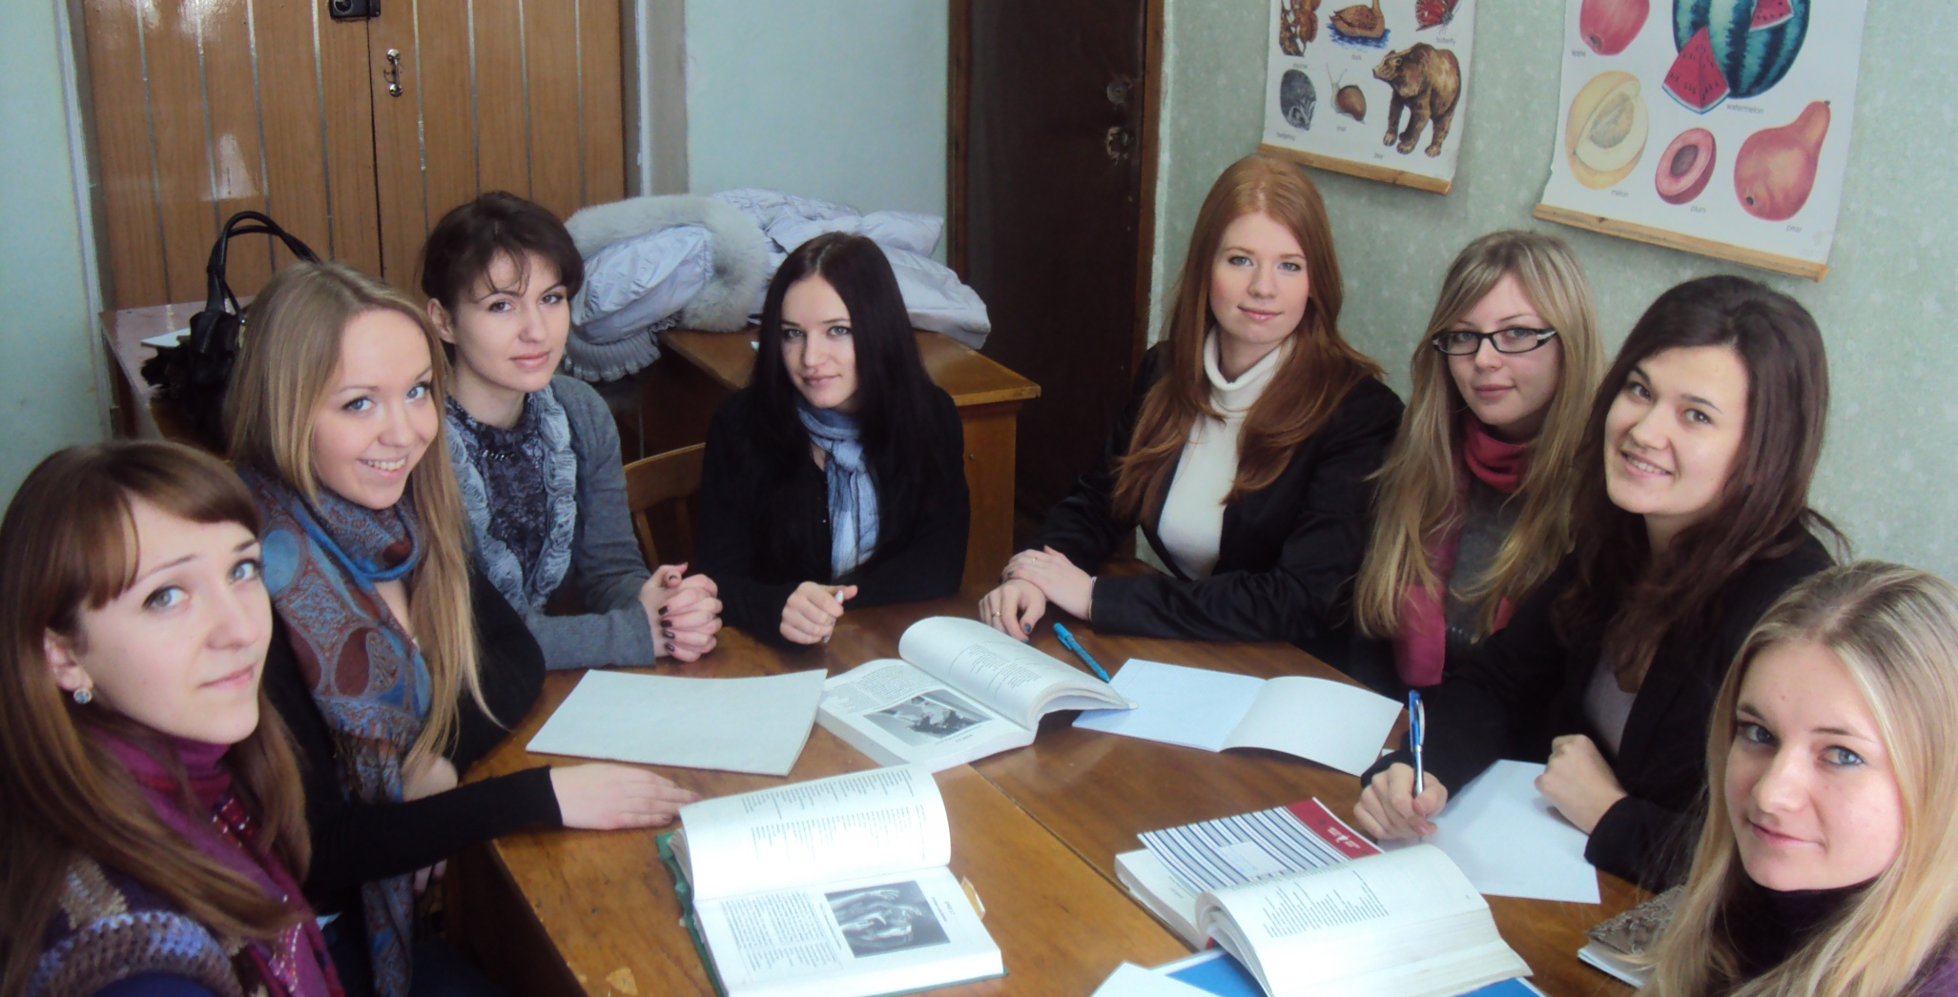
Discussion is interactive, student-centered exploration of realistic and specific narratives. The students are engaged in the intellectual and emotional exercise of facing complex problems and making critical decisions within limited time and information, and pervasive uncertainty.

Slide 13
Brainstorming
Brainstorming is the name given to a situation when a group of people meet to generate new ideas around a specific area of interest. Using rules which remove inhibitions, people are able to think more freely and move into new areas of thought and so create numerous new ideas and solutions. The participants shout out ideas as they occur to them and then build on the ideas raised by others. All the ideas are noted down and are not criticized. Only when the brainstorming session is over the ideas are evaluated.

Slide 14
Problem Solving
Commonly used in adult classes, problem solving focuses on meaningful content. The problem may be simple (giving directions) or complex (dealing with a social issue). To solve the problem efficiently, the members of the group must interact and reach a consensus after analyzing all the aspects of the problem. Similarly, decision-making techniques require students to make a decision in a given situation.

Slide 15
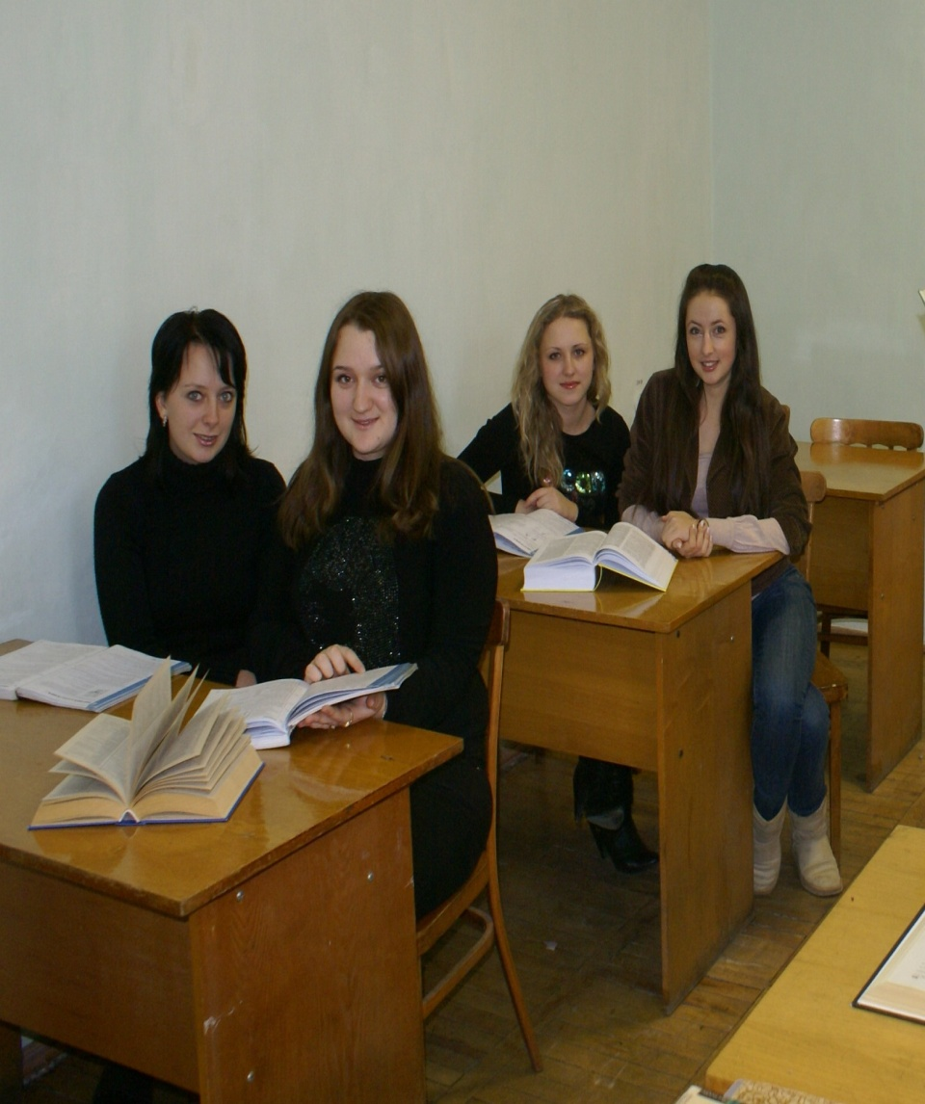
Opinion Exchange
Opinion exchange deals mostly with beliefs and feelings. It may involve issues like cultural differences, marriage, human rights and politics. Teachers should select the topics carefully, as some of them may involve personal opinions that may be ridiculed or offend other students. Before the activity, the teacher should explain to the students that all opinions deserve to be valued.

Slide 16
The Project Method
Game
Website
Performance
Report
Article
Video Film
Placard
Album

Slide 17
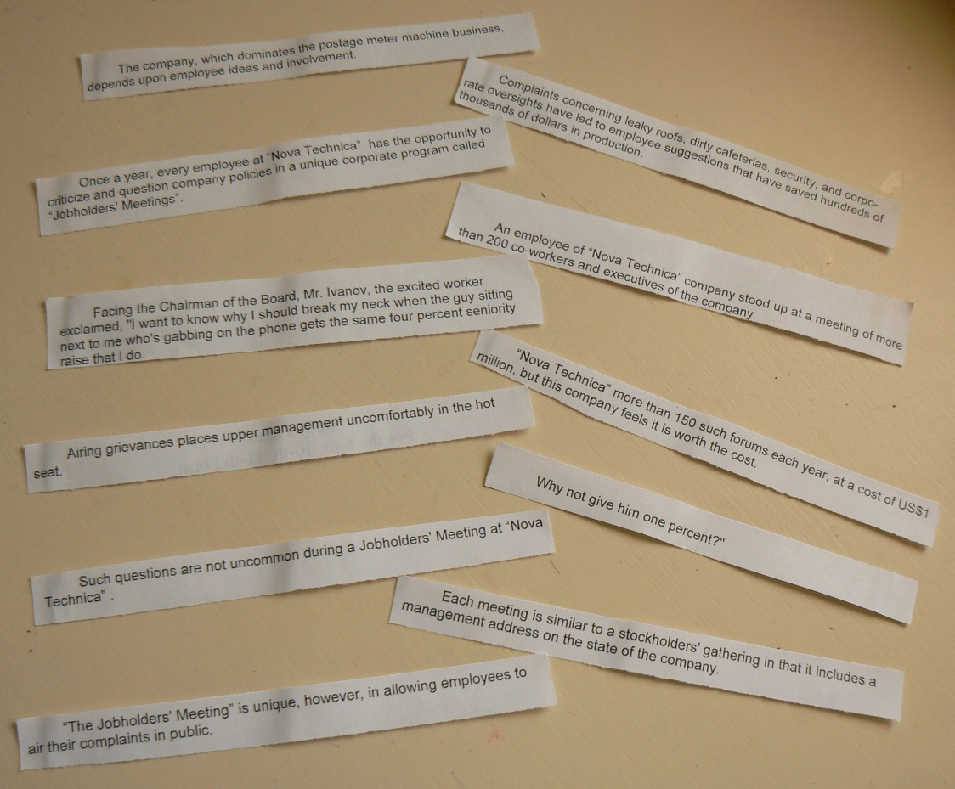
Jigsaw Reading

Slide 18
Multiple choice
Choose the proper word to
finish the definition.
1.To inspire, to give reason to someone to do something.
  A motivate
  B promote
  C provoke
2.A person employed by someone else, working for money.
  A earner
  B employee
  C employer
3.Relations between employers and employees.
  A human relations
  B labour relations
  C human unions
4.Having control of something as part of your job.
  A command
  B power
  C responsibility
5.Money paid per hour, day, week, to manual workers.
  A earnings
  B salary
  C wages

Slide 19
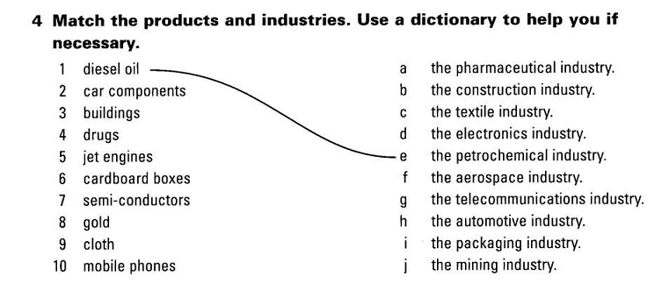
Matching

Slide 20
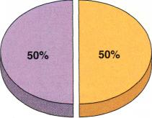
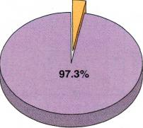
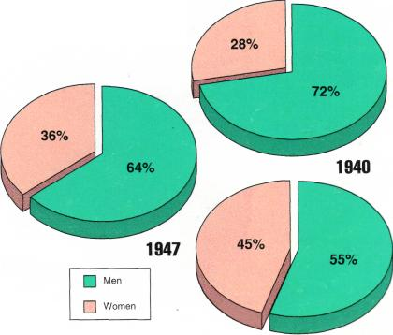
True | False
Study the graphs below and say if the statements are true or false.
1. The proportion of women in the labor force
has remained about the same since 1940.
2. Less than 4 percent of the labor force today
is involved in farm work.
3. Productivity gains were the result of
improving technology and methods of
production.
4. Female workers earn less than male
workers.
5. The data indicate that work­ers with more
schooling earn higher wages than those
with less schooling.
6. The most significant differ­ence in earnings
is between those who graduated from high
school and those who did not.
7. It is very likely, if trends con­tinue, that all
workers will need at least a high school
diploma by the year 2000.
Farm Workers in the Labor Force.
Proportions of Women in the Labour Force per 100 Workers.

Slide 21
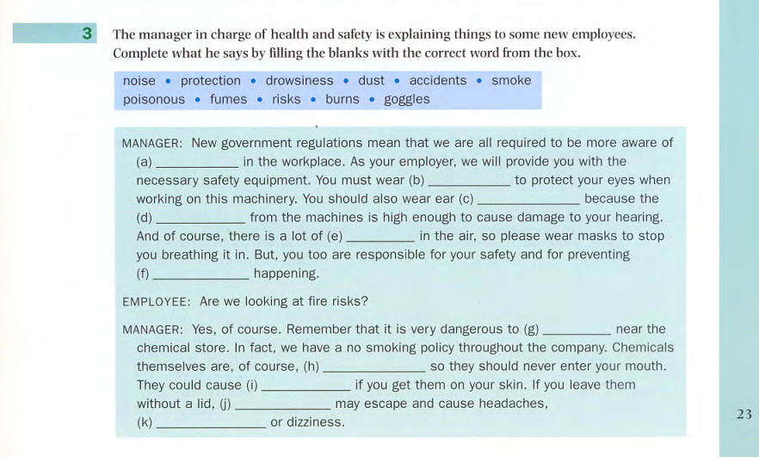
Gap-filling

Slide 22
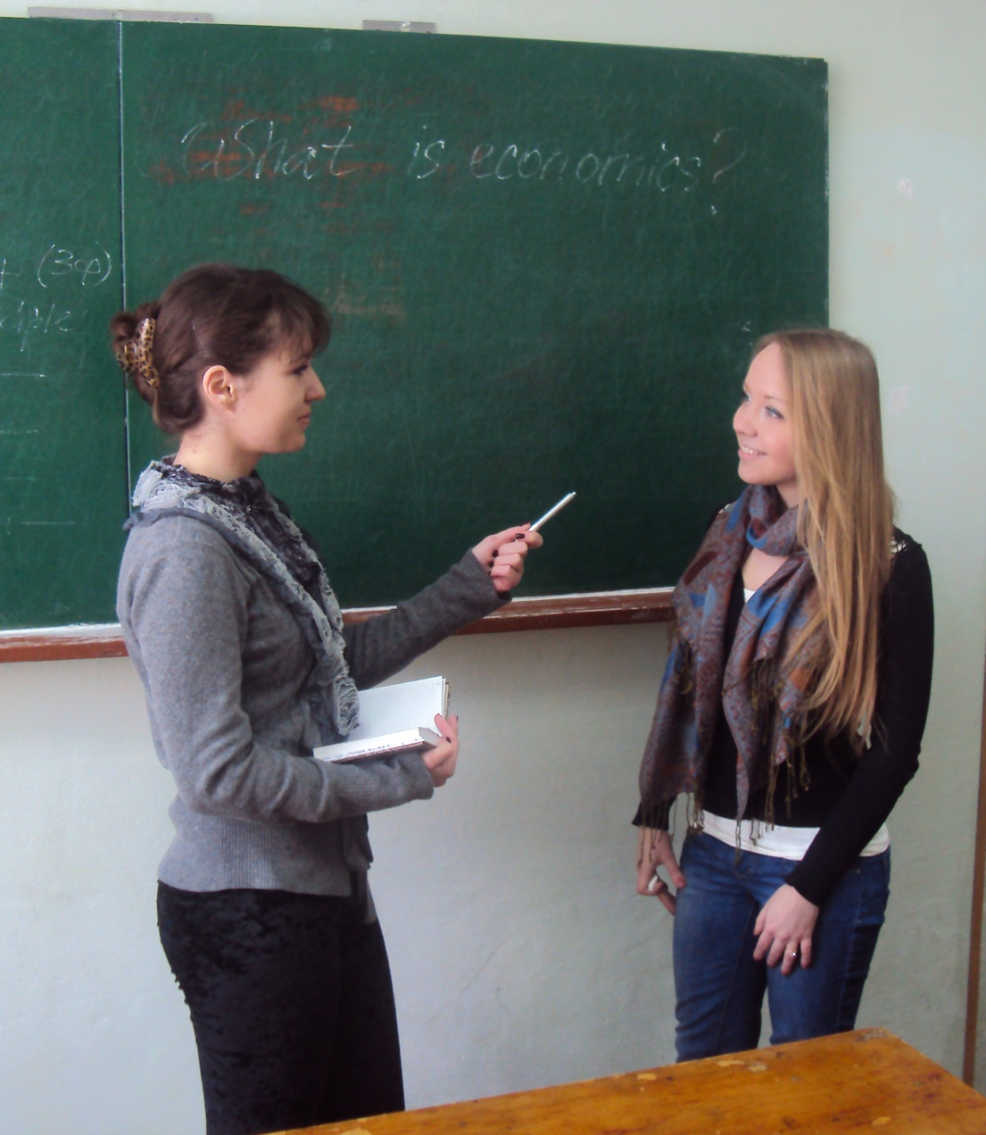
Role Play
Students act out a particular situation to achieve a predetermined objective. For example, a dialogue between an employer and a possible candidate for a job focuses on the interview they have.

Slide 23
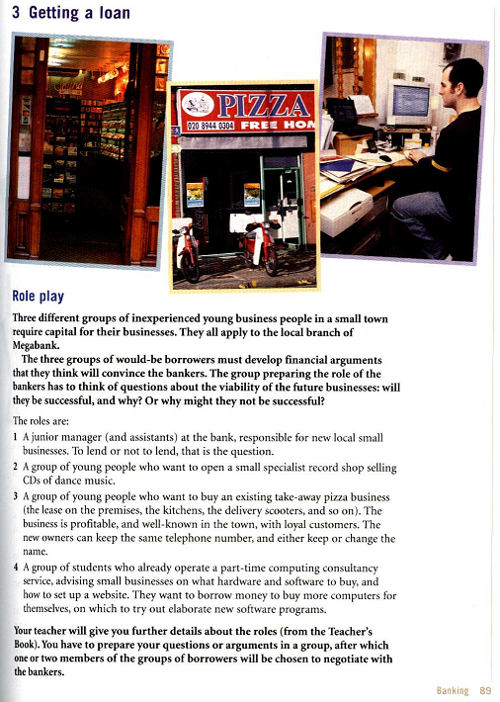
Role Play

Slide 24
Case Study Techniques
This type of training technique presents the trainee with questions to answer and objectives to meet. Given authentic problems to solve, with no particular right or wrong answers, students are encouraged to use their own life experiences to come up with viable answers. This method gives mature students an opportunity to contemplate the many variables and factors that managers are forced to deal with daily when making decisions.

Slide 25
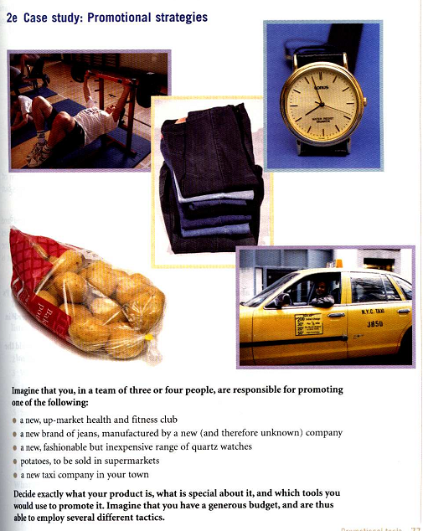
Case Study

Slide 26
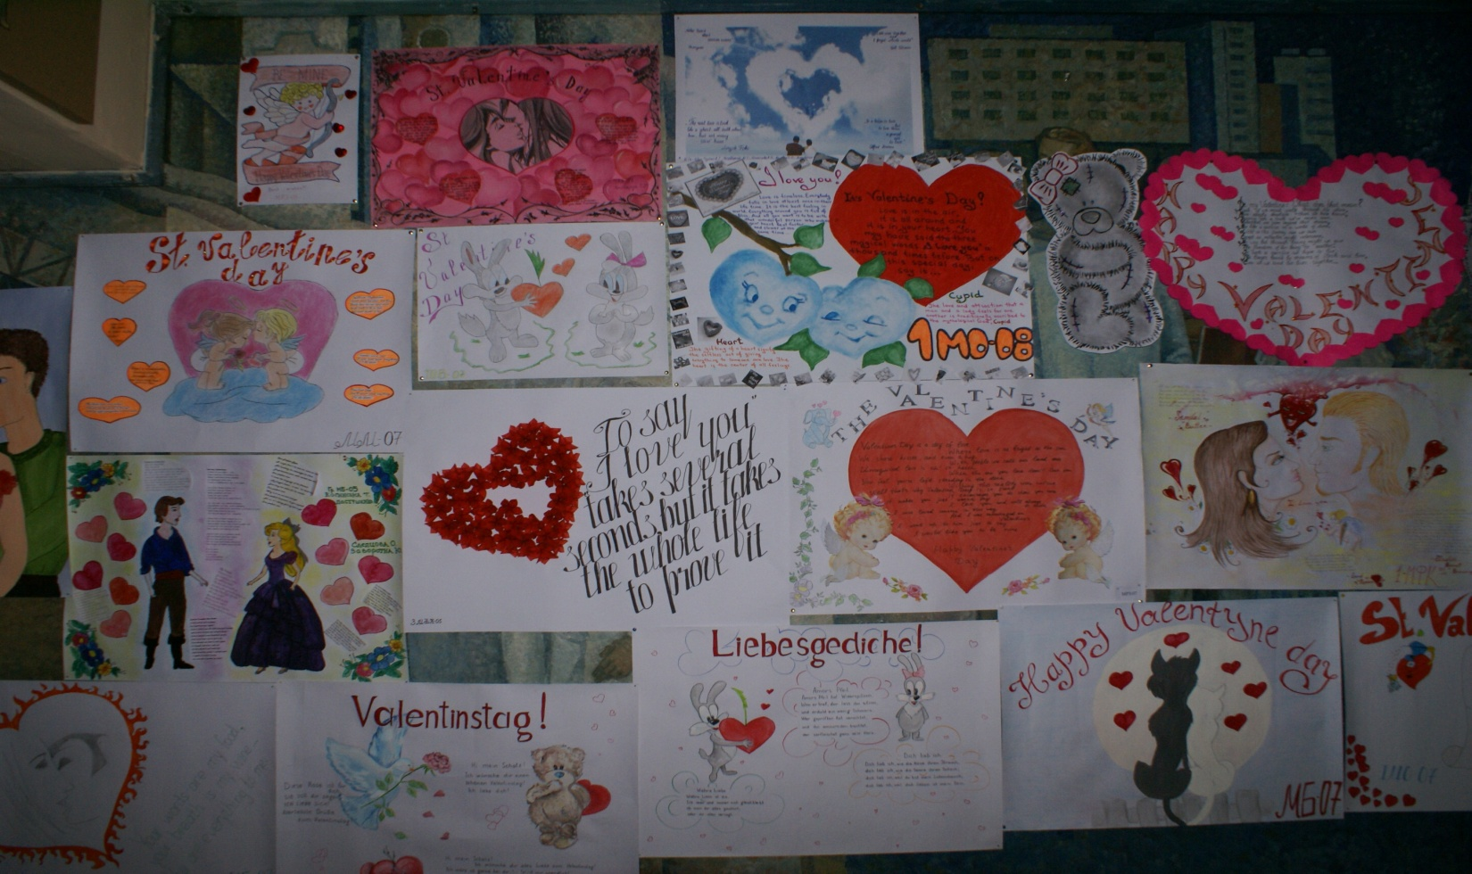
St. Valentine’s Day

Slide 27






English Language Olympiad

Slide 28
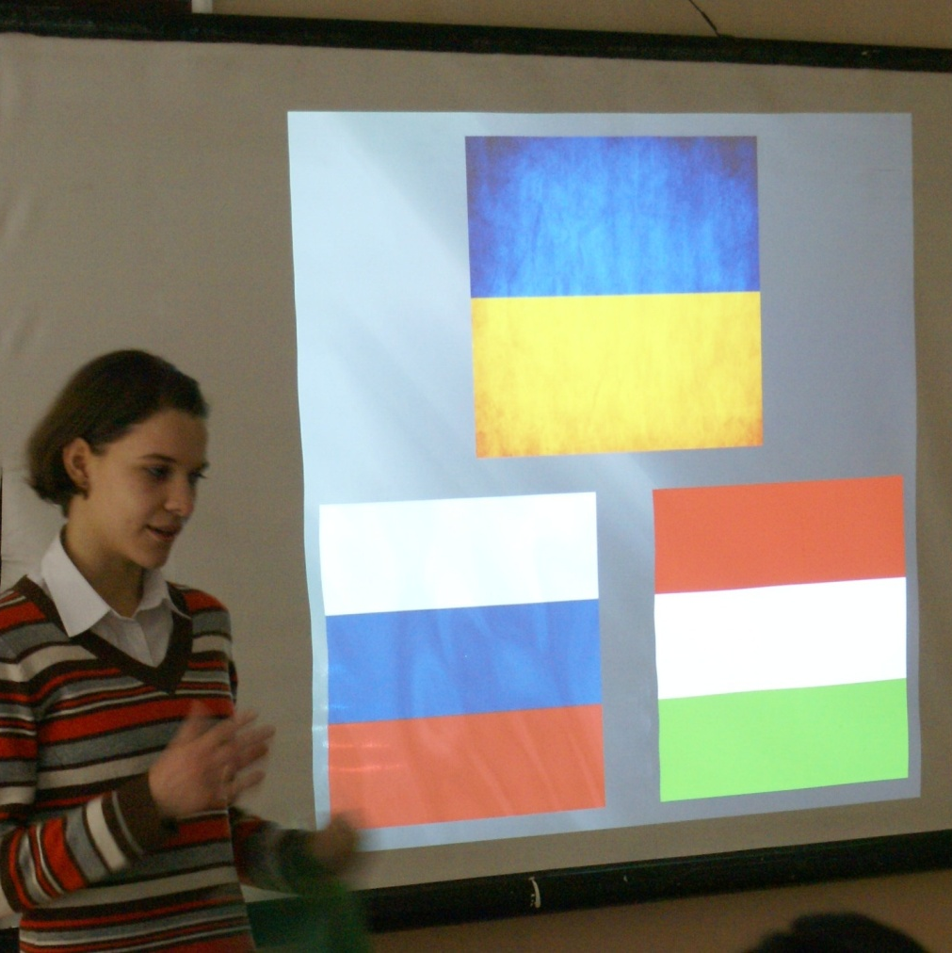
The Scientific Conference

Slide 29
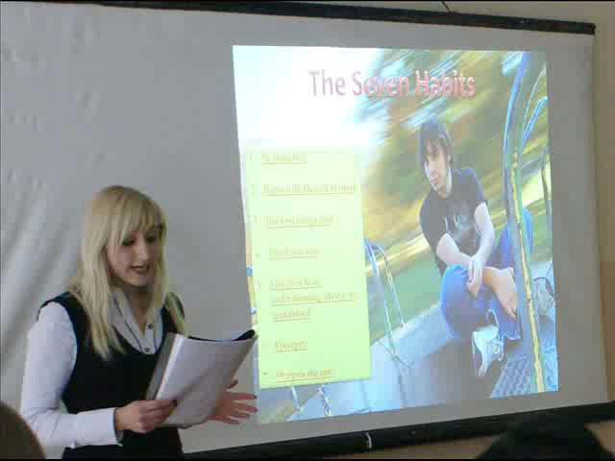

Slide 30
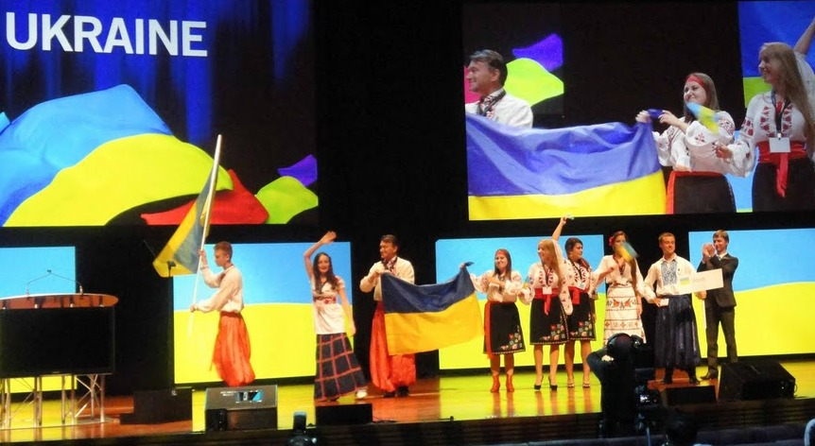

“SIFE World Cup 2011”

Slide 31


The Concert

Slide 32


Slide 33
The effectiveness of teaching foreign languages
Interactive approach
Students master foreign
language continually
Orientation of training tasks towards future
professional activity of students
Taking interest in foreign
languages constantly
Strong desire for self-improvement

Slide 34
Thank you
for your attention!

